Slide 1
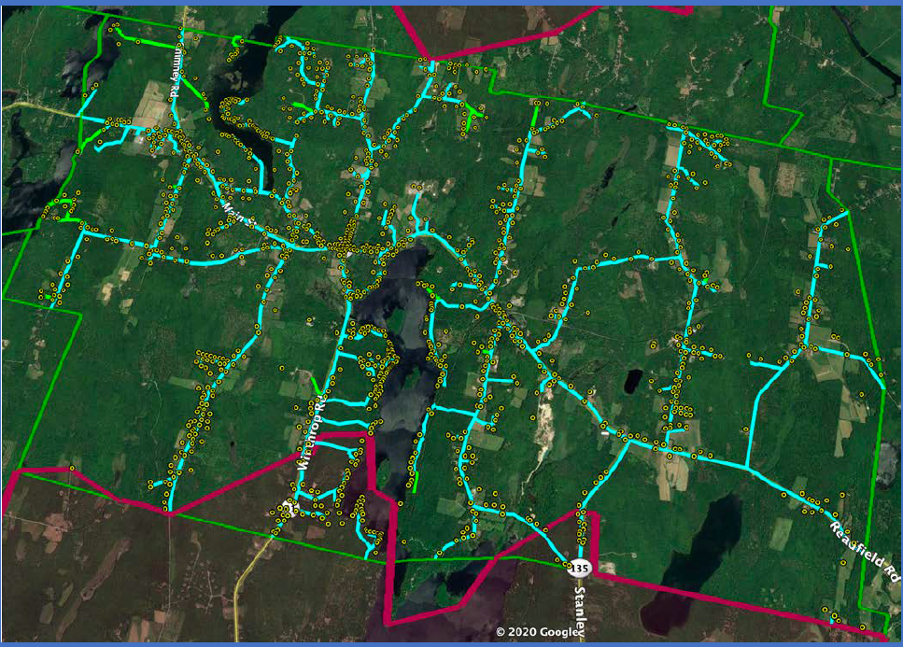
Town of Readfield Broadband Model Assessment
April 28, 2021

Slide 2
Readfield FTTH Model Assessment
Purpose
Evaluate Broadband solution options that address the community Broadband needs
Explore FTTH model constructs leveraging the Casco Bay Advisors LLC Proforma
Assess Capital investment, Operational Cost, Model Benefits and Risks
Assess the Spectrum Franchise Agreement terms and conditions relative to unserviced areas
Competitive offering and price point assessment
Determine next steps
Scope
This assessment is limited to Broadband Internet service
Primary focus on Town of Readfield
Economy of scale assessment of multi-community coalition approach
Methodology
Visual representation of model constructs
Define model construct demarcation ownership
Pros/Cons/Risks assessment
Model Summary
Operational model variances, benefits and risks
Assess model capital and operational cost
Franchise Agreement applicable terms and conditions assessment
Provider product and pricing
Summary level competitive landscape and current provider product and pricing
Multi Community Model
Assessment of multi-community Capital and Operation cost economies of scale
Next Steps

Slide 3
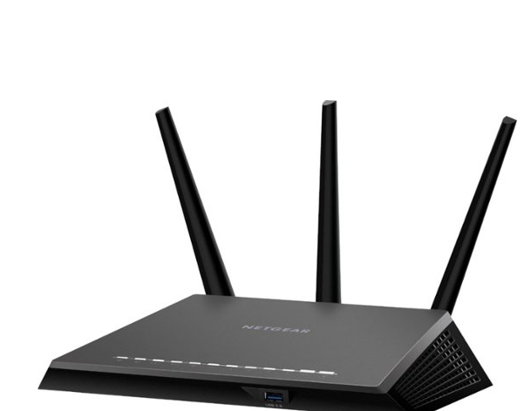
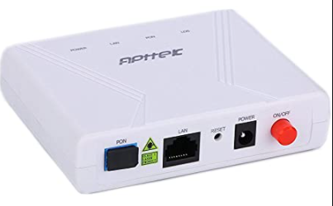
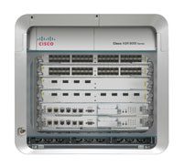
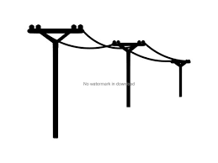
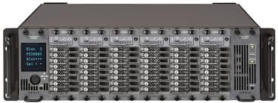
Single Provider Model Ownership Demarcation
ISP Services
Network HUB
Outside Network Plant
House Line
Optical (ONU)
Customer Premise
IP Transit
Network Provider
Router/Aggregator
OLT
Optical TX/RX
Cost Owner
Network Provider
Town owned/Provider maintained
Town owned/Provider maintained
Town owned/Provider maintained
Network Provider
Customer
Service Provider is the Network Provider
The Town carries the Capital investment, operational cost and financial risk for all aspects of the Network
The Network Provider provides, maintains and replaces the customer premise ONU equipment
Customer owns and maintains the premise WiFi equipment

Slide 4
Open Provider Model Ownership Demarcation
ISP Services
Network HUB
Outside Network Plant
House Line
Optical ONU
Customer Premise
IP Transit
Service Provider 1
Location:
Town Power/Space
Data Center colocation
Service Provider 2
Router/Aggregator
Service Provider 3
OLT
Optical TX/RX
Cost Owner
Network Providers
Town owned and maintained
Town owned/Provider maintained
Town owned/Provider maintained
Network Provider
Customer
The Town owns and maintains the network through vendor contracts agreements(s).
The Town assumes the Capital investment, operational cost and financial risk for all aspects of the Network
Service provides own and maintain the customer premise ONU equipment
Customer owns and maintains the premise WiFi equipment

Slide 5
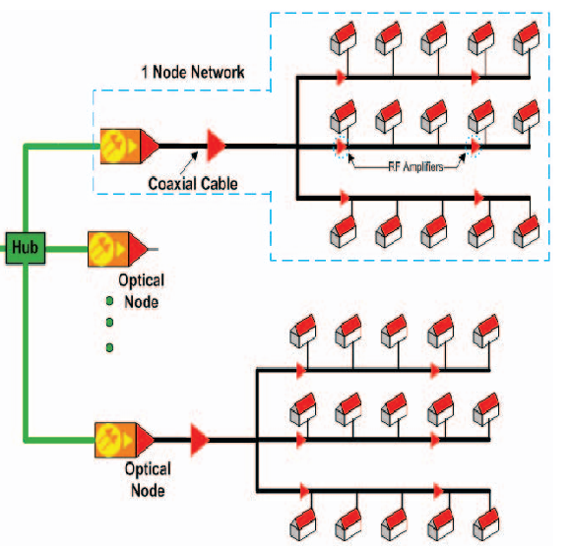
Spectrum Model Ownership Demarcation
ISP Services
Network Headend
Outside Network Plant
House Line
Optical ONU
Customer
IP Transit
Router/Aggregator
Spectrum
OLT
Optical TX/RX
Cost Owner
Spectrum
Spectrum
Spectrum
Spectrum
Spectrum
Spectrum
Spectrum provides and maintains all ISP, Network construction, house drop, ONU, WiFi and customer technical support
Town of Readfield receives 5% of gross annual “cable” revenue in the form of a Franchise Fee

Slide 6
Model Summary
Business Model | CAPEX Model | Communities | CAPEX Cost Ownership | Provider Access | Provider paid fees to town(s) | Provider fees to Town(s) | IP Transit Cost | Plant Maint. Cost | House Drop Cost | Premise ONU | Customer Premise Equipment (CPE) Wifi
Single Provider | Town(s) | Single/Multiple | Town(s) | Single Exclusive | None | Per Customer | Town(s) | Town(s) | Town(s) | Town(s) | Customer
Open Provider | Town(s) | Single/Multiple | Town(s) | Open Provider | Per Customer | None | Providers | Town(s) | Town(s) | Town(s) | Customer
Spectrum | Spectrum unserved | Single | Provider/ Shared | Single | None | None | Provider | Provider | Provider | Provider | Provider
Single Provider
Town(s) assumes construction CAPEX cost
Town(s) assumes operational cost of Plant and houseline maintenance
Residents do not have a choice of providers
Product offerings, features, Apps etc. dependent on a single provider offering
Remote/Mobile access to services
Self Service technical support App
Speed tier and price point options
WiFi parental controls
Email and WiFi security
Subscriber is responsible to provide, troubleshoot and Maintain WiFi device
Town(s) assumes the majority of financial risk
Open Provider
Town(s) assumes construction CAPEX cost
Town(s) assumes operational cost of Plant and houseline maintenance
Non facility Providers (3rd party) have access to sell and deliver service to previously unreachable residents
Residents have a choice of providers
Competition drives service offerings, features and development
Providers must have the ability to provide, provision and maintain subscriber premise ONU devices
Subscriber is responsible to provide, troubleshoot and Maintain WiFi device if not included by service Provider
Town(s) assume the majority of financial risk
Spectrum
Town(s) assumes limited to no CAPEX cost
Provider assumes all Plant, House drop maintenance and operational cost
Product offerings, features and development are dependent on a single provider
Town has leverage in the Franchise Agreement to require extension to unserviced homes and potentially future product offerings
Subscriber ONU and WiFi device, maintenance and repair are included in the subscription fee
Does not provide a multi-community model option
$22.99 Low-income product offering

Slide 7
Three Model Assessment
Single Provider
Open Provider
Spectrum
Model | Benefits | Success Dependencies | Risk
Town funded CAPEX Single Provider | One Provider contract, simpler model to deploy and manage Guaranteed Provider to deliver service One Provider relationship Single provider network interface, support and maintenance Single Simpler product construct Single entity of customer experience and relationship | Provider offers, develops and maintains competitive product offerings over the term of the agreement Provider is responsive to residents changing needs and service requirements Provider delivers a competitive quality subscriber experience Resident's support funding build-out of the network Service penetration rate meets the model of 40% Subscriber willingness to purchase, support and maintain their own WiFi device. Broadband only pricing being competitive in light current provider(s) bundling discounts | The network financial burden is carried by the taxpayer Residents may view this model as a taxpayer subsidy that provides profit to a single Provider Success is dependent securing a single provider Provider does not keep pace with competitive product evolution of product features Provider goes out of business The Town of Readfield carries a majority of operational financial risks whereas the Provider assumes minimal financial risk Revenue shortfall solution if fewer than 40% resident subscribe to service Subscriber willingness to purchase, maintain, upgrade and troubleshoot their own WiFi
Town funded CAPEX Multiple Provider (Open Network) | 3rd Party Providers have access to residents currently only available through DSL line lease Option to charge 3rd Party Providers an access fee similar to fees they pay for a DSL circuit to access residents Providers gain access through ISP transport to the network Residents have a choice of providers Providers are incented to provide quality service and improve products through competition | Simplified Provider agreements A compelling business case construct for 3rd party Providers to connect to the network Town securing Router and ONT service and maintenance contract with a qualified vendor Solution for the Network maintenance installation/service of house drop lines to Subscribers Establish a provider colocation site with multiple providers for ease of connection to the network, typically a data center Provider leased circuit billing and accounting solution | Town secures a contract with a colocation provider to act as a Provider “Meet Me” point Lack of Provider interest in connecting to the network and ability to provide Subscriber ONU provisioning Multi layer complexity customer technical support due to the shared resources and traffic hand-offs between the Provider and the subscriber ONU
(Charter) Spectrum Expansion | Established provider to 94% of residents The Franchise Agreement status and provisions may address unserviced area issues Current Franchise Agreement may be expired thereby potential leverage to require build out of unserved residents Deployed technology ability to provide Gig + services | The Town holds Charter accountable to the terms and conditions of the Franchise Agreement The Town takes the legal position that a Franchise renewal is not a perquisite to holding Charter to terms and conditions of the current active agreement | Charter takes the position a franchise renewal is a perquisite to extending service to unserviceable Residents Timeline of a 1Gig+ level of services Charter determines product offering and development timing

Slide 8
Single Provider Model Breakeven Assessment
Break-even Construction and Operating Cost
Subscriber % | Monthly/ Subscribers | Service Rate | Subscriber Revenue/Mo | OPEX Monthly | VAR/Mo | VAR Annualized | Cost of Service per Customer
40% | 532 | $70 | $37,268 | $58,280 | -$21,012 | -$252,141 | $109.5
50% | 666 | $70 | $46,585 | $60,396 | -$13,811 | -$165,732 | $90.8
60% | 799 | $70 | $55,902 | $62,512 | -$6,610 | -$79,324 | $78.3
70% | 932 | $70 | $65,219 | $64,629 | $590 | $7,085 | $69.4
75% | 998 | $70 | $69,878 | $65,687 | $4,191 | $50,289 | $65.8
Assessment of subscription fee and take-rate required to cover “all-in” cost to achieve a self-funded model
$109/mo all-in per Subscriber cost based on a 20-year 40% sustained subscription take-rate
70% 20-year sustained subscription take-rate required to achieve self funded result
A 70% take-rate is not deemed achievable nor sustainable over a 20 year period
Break-even Operating Cost Only
Subscriber % | Monthly/ Subscribers | Service Rate | Subscriber Revenue/Mo | OPEX Monthly | VAR/Mo | VAR Annualized | Cost of Service per Customer
40% | 532 | $70 | $37,268 | $35,150 | $2,118 | $25,419 | $66.0
50% | 666 | $70 | $46,585 | $37,266 | $9,319 | $111,828 | $56.0
60% | 799 | $70 | $55,902 | $39,382 | $16,520 | $198,236 | $49.3
70% | 932 | $70 | $65,219 | $41,499 | $23,720 | $284,645 | $44.5
75% | 998 | $70 | $69,878 | $42,557 | $27,321 | $327,849 | $42.6
Subscription take-rate required to cover operational cost at a $70/mo price point
$66/mo per Subscriber cost based on a 20-year 40% sustained subscription take-rate
Potential for lowering subscription rate if higher take-rate is achieved

Slide 9
Open Provider Model Breakeven Assessment
Construction and Operating cost break-even assessment
Multi Provider model incorporating a per subscriber circuit fee for use of the Network
3rd Party providers are accustomed to leasing circuits from a facility provider to deliver service to Subscribers. Currently DSL is their only option which does not provide a competitive service to Spectrum
Stable monthly Network OPEX cost
Providers would set service tiers and subscription price points
A 60% take-rate, $50 circuit lease rate with a $90/mo subscription fee would be required to absorb construction and operating cost.
Circuit lease fee would not offset capital and operational cost
Provider willingness to pay a $35-$50 per Subscriber circuit fee requires further study
Open Provider Breakeven Construction and Operating Cost
Subscriber % | Monthly/ Subscribers | Service Provider Rate | Circuit Fee/ Subscriber | Leased Circuit Revenue | Net OPEX Monthly | VAR/Mo | VAR Annualized | Cost of Service per Customer
40% | 532 | $70 | $35 | $18,634 | $42,171 | -$23,537 | -$282,448 | $79.2
45% | 599 | $75 | $35 | $20,963 | $42,171 | -$21,208 | -$254,497 | $70.4
50% | 666 | $80 | $35 | $23,293 | $42,171 | -$18,879 | -$226,546 | $63.4
55% | 732 | $85 | $35 | $25,622 | $42,171 | -$16,550 | -$198,595 | $57.6
60% | 799 | $90 | $50 | $39,930 | $42,171 | -$2,241 | -$26,896 | $52.8
Open Provider Breakeven Operating Cost
Subscriber % | Monthly/ Subscribers | Service Provider Rate | Circuit Fee/ Subscriber | Leased Circuit Revenue | Net OPEX Monthly | VAR/Mo | VAR Annualized | Cost of Service per Customer
40% | 532 | $70 | $35 | $18,634 | $19,024 | -$390 | -$4,680 | $35.7
45% | 599 | $70 | $35 | $20,963 | $19,024 | $1,939 | $23,271 | $31.8
50% | 666 | $70 | $35 | $23,293 | $19,024 | $4,269 | $51,222 | $28.6
55% | 732 | $70 | $35 | $25,622 | $19,024 | $6,598 | $79,173 | $26.0
60% | 799 | $70 | $35 | $27,951 | $19,024 | $8,927 | $107,124 | $23.8
Operating cost break-even assessment
Multi Provider model incorporating a Provider lease circuit fee for use of the Network
3rd Party providers are accustomed to pay a facility provider to deliver service to Subscribers. Currently DSL is their only option which does not provide a competitive service to Spectrum
Stable monthly Network OPEX cost
Circuit fees nearly offset operational cost at a 40% take rate, $70/mo service rate with $35 per subscriber circuit fee
Provider willingness to pay a $35/mo per Subscriber fee requires further study

Slide 10
Spectrum Model and Franchise Agreement Assessment
Franchise Agreement relevant provisions
The current Franchise agreement is/was effective March 8, 1999 for a term of 12 years.
Is there a more current agreement?
Have any renewal dialog occurred?
In the event the Franchise Agreement is expired, this may offer leverage to require network extension to the 83 unserviced homes.
An Agreement renewal can be a lengthy process which would extend the time to service these residents.
In the event this option has not been exercised, and precedent being the agreement is in effect, the agreement tenure is 23 years.
Under this provision the Grantor elected extension of service could be as much as 11.5 miles
Section 2.3.1 stipulates the Grantor has the option to require extension of service one-mile per two-year period regardless of density.
A 12-year team translates to 6 miles of Grantor elected service extension areas
Has this provision ever been exercised?
4.8 miles of unserviced areas with 83 homes equates to 17.3 homes per mile.
Assuming a cost of $45,000 per mile, the estimated cost of 4.8 miles is $216,000 or $2,500 per home.
83 homes at $2500 per subscriber equates to a $207,500
The contribution to construction cost equates to $8500
Allocating $8500 from the 5% Franchise fee may be a funding option
Given the unserviced areas require relatively a short network extension, the cost per mile will most likely be lower than $45,000 per mile
Given this provision references “Subscriber(s)”, residents may be required to subscribe to service; however, there is not a length of term requirement
Section 2.3.1(d) also stipulates the Franchisee shall make service available to “low density extension areas” which fall below 18 homes per mile. This provision stipulates a subscriber has the option to contribute to the cost equal to the difference between the actual cost at the 18 homes per mile verses the actual homes per mile.

Slide 11
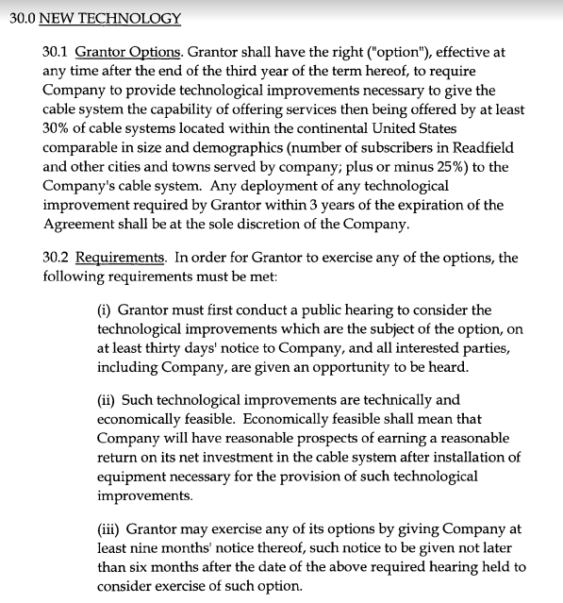
Spectrum Franchise Agreement
Potential leverage to upgrade service level offerings
Build-out with Contribution option
Current Unserved homes 17.3 Homes/mile

Slide 12
Competitive Landscape Summary
Consolidated Communications and Spectrum are the two primary facility based Broadband providers with significant geographic coverage
Consolidated Communications offers up to 50Mbps for $56/mo with a distance limitation of less than a mile from the Central Office
Spectrum offers plans of 200Mbps up to 940Mbps which is not distance limited and priced between $50/mo to $110/Mo
RedZone offers 5Mbps fixed wireless for $44/mo with coverage based on a case-by-case site assessment
Trail Runner offers mobile wireless 25Mbps for $80/mo with coverage based on a case-by-case site assessment
Competition Assessment | Facilities Based | Coverage | Leased DSL Circuit | Circuit Leased by | 5Mbps | 10Mbps | 25Mbps | 50Mbps | 200Mbps | 400Mbps | 940Mbps | Low Income Plan
Consolidated Comm | Yes | 95% | No | NA |  | $33 ~12,000’ | $44 ~8000’ | $56 ~4500’ | NA | NA | NA | 2Mbps $9.25
Spectrum | Yes | 94% | No | NA |  | NA | NA | NA | $50 | $70 | $110 | 30 Mbps $22.99
3rd Party Providers | No | 95% | Yes | Provider |  | NA | NA | NA | NA | NA | NA | NA
Red Zone | Fixed Wireless | 32% | No | NA | $44 |  | NA | NA | NA | NA | NA | NA
Trail Runner | Mobile Wireless | Unknown | No | NA |  | NA | $80 | NA | NA | NA | NA | NA

Slide 13
Single Provider Multi-Community Coalition Assessment
Readfield has the highest homes per mile density and the lowest average cost per home and Subscriber
$8,300 construction cost per Subscriber at a 40% take-rate
Readfield has the great % of Broadband coverage
The other five communities most likely qualify for Federal Rural Broadband funding whereas Readfield most likely will not qualify
Community | BB Coverage | Miles | Homes | Home/Mile | Construction Cost | Cost/Mile | Cost/Home | Cost/Subscriber 40% Subscription | Cost/Subscriber 50% Subscription
Readfield | 94% | 66.8 | 1331 | 19.9 | $4,414,079 | $66,061 | $3,316 | $8,291 | $6,633
Fayette | 9% | 54.4 | 825 | 15.2 | $3,632,321 | $66,815 | $4,403 | $11,007 | $8,806
Leeds | 71% | 66.8 | 1121 | 16.8 | $4,308,401 | $64,479 | $3,843 | $9,608 | $7,687
Mt Vernon | 64% | 78.5 | 1141 | 14.5 | $5,116,265 | $65,188 | $4,484 | $11,210 | $8,968
Vienna | 0% | 31.5 | 428 | 13.6 | $2,107,102 | $66,924 | $4,923 | $12,308 | $9,846
Wayne | 75% | 49.5 | 881 | 17.8 | $3,473,530 | $70,237 | $3,943 | $9,857 | $7,885
TTL |  | 347.4 | 5727 | 16.5 | $23,051,698 | $66,350 | $4,025 | $10,063 | $8,050
Coalition cost benefit potential
Estimated potential 5%-7% material savings
Considering the Rural Broadband initiative activity nationally, the demand for construction contractor resources will exceed supply. Therefore, we should expect construction labor cost to increase
Economy of scale materials saving may be offset by higher construction labor cost
Low to moderate operational cost savings for Plant maintenance, Network maintenance and per subscriber fee in the single provider model
Risk: A multi-community coalition will extend the solution timeline which may not outweigh the benefit
Town(s) Owned Network Operational Model | Multi-Town scale savings | Cost Ownership | Resource | Fee Structure | Options
Plant Construction cost | Marginal | Town(s)/Customer | Provider | Per Mile | 3rd Party Contract
House Service Line Install | Marginal | Town(s)/Customer | Provider | Per incident | 3rd Party Contract
House Service Line Maint/Repair | Low | Town(s)/Customer | Provider | Per incident | 3rd Party Contract
Home Service/Repair visit | Low | Town(s)/Customer | Provider | Per incident | No viable option
Network-Plant Maintenance | Moderate | Town(s)/Customer | Provider | Per incident | 3rd Party Contract
Capital Improvements/Upgrades | Moderate | Town(s) | Provider | Per incident | 3rd Party Contract
Customer Billing | None | Provider | Provider | Per customer | No viable option
Customer Technical Support | Low | Provider | Provider | Provider | No viable option
Customer ONU Main/Repair/Replace | Low | Town(s) | Provider | Per incident | No viable option
Customer Premise WiFi CPE | None | Customer | Provider | None | No viable option
Bad Debt | None | Town(s) | Town(s) | Per Customer | No viable option

Slide 14
Next Steps

